Slide 1
Week 2
Rigid block motion
Plate motion on a sphere
Continuum kinematics (intro)

Slide 2

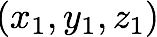
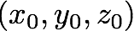
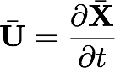
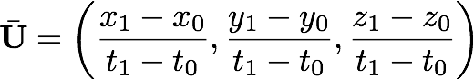
Motion and coordinate systems
z
Motion is a vector quantity
All motion is with respect to an origin
Velocity is the time derivative of the displacement vector
x
y

Slide 3
Reference frames and relative motion
A
B
Blocks move relative to an origin/reference frame
You can decide where that origin is
A
B
A
B

Slide 4
Reference frames and relative motion
Initial
Origin fixed
A fixed
A
A
A
B
B
B

Slide 5

Relative motion
10 mm/yr
15 mm/yr
A
B
C
Find

Slide 6
Circuit closure
1
2
3

Slide 7
Circuit closure
Find ₁U₄ and ₃U₄
1
2
3
4

Slide 8
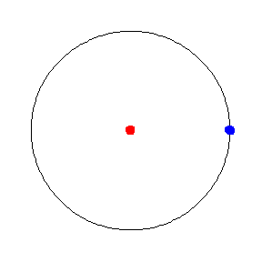
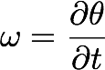
Rotations in Cartesian coordinates
Blocks motion can be described as a rotation around an origin (Euler pole)

Slide 9
Rotations in Cartesian coordinates
Blocks motion can be described as a rotation around an origin (Euler pole)
Velocity varies with distance, but angular velocity is constant

Slide 11
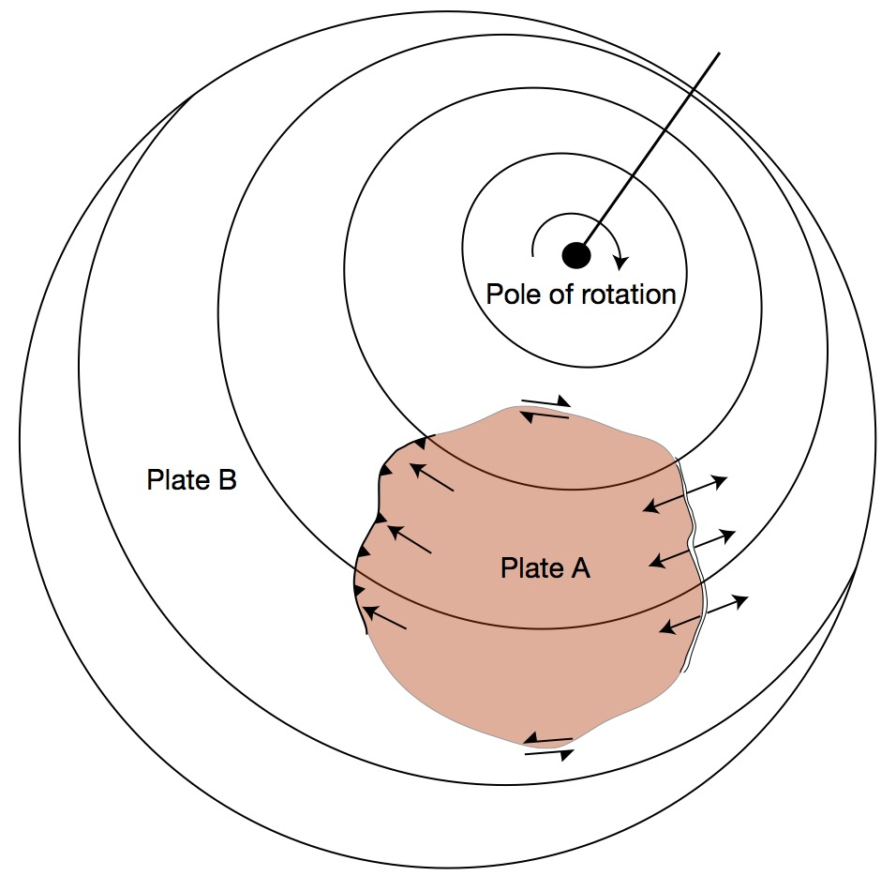
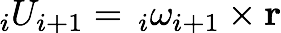
Rotations on a spherical Earth
The same rules as for flat system
The Euler pole does not have to be on any plate - it is imaginary
We need the Euler pole to describe relative rotation
Linear velocities are calculated from angular velocities

Slide 12
Coordinate transformations
From spherical <-> 3-d cartesian
co-latitude
latitude
For a given euler pole (spherical coordinates), we can calculate the rotation vector in cartesian coordinates

Slide 13
Coordinate transformations
To calculate velocities in a local N,E,U basis
we need 1 rotation along the co-latitude (from Z to U)
and a second rotation to align X with E.
2 rotations to convert from x,y,z to e,n,u

Slide 14
Coordinate transformations

Slide 15
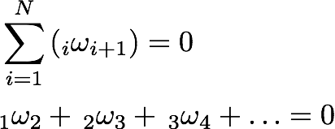
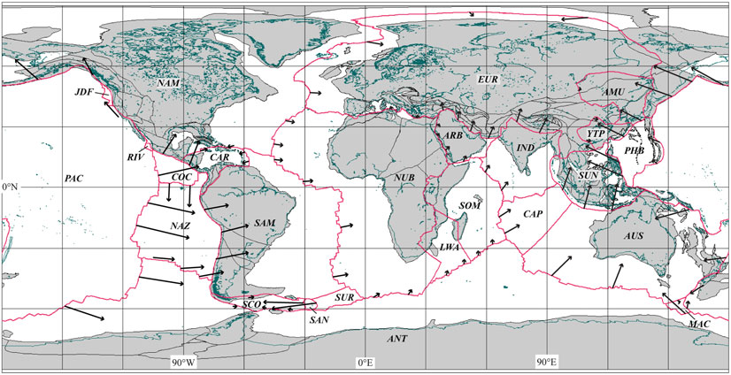
Rotations on a spherical Earth
Angular velocities are additive
DeMets et al., (2010)

Slide 16
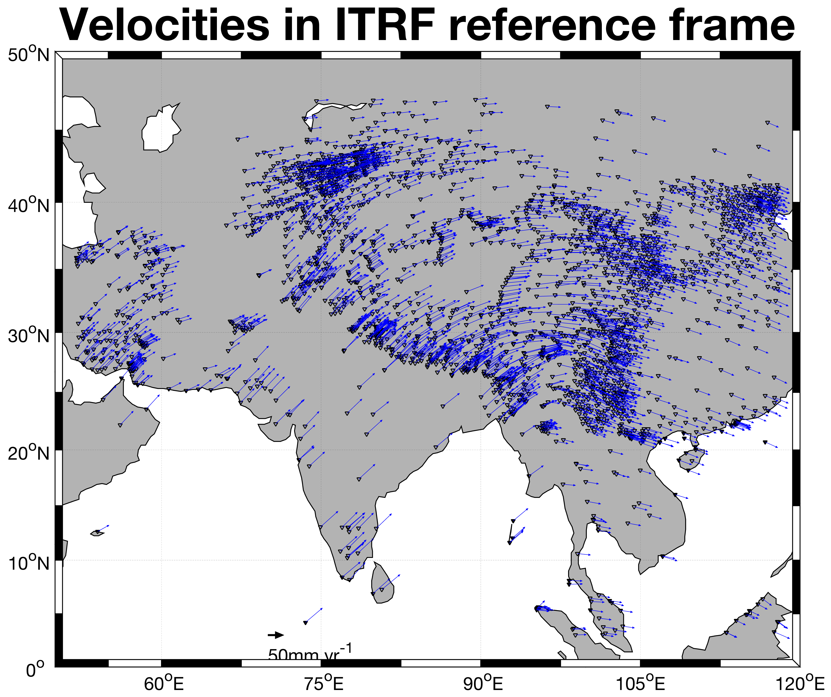
Reference frames and rotations (again)
Different from rotating vectors into different coordinate systems. Here the vector lengths itself change.

Slide 17
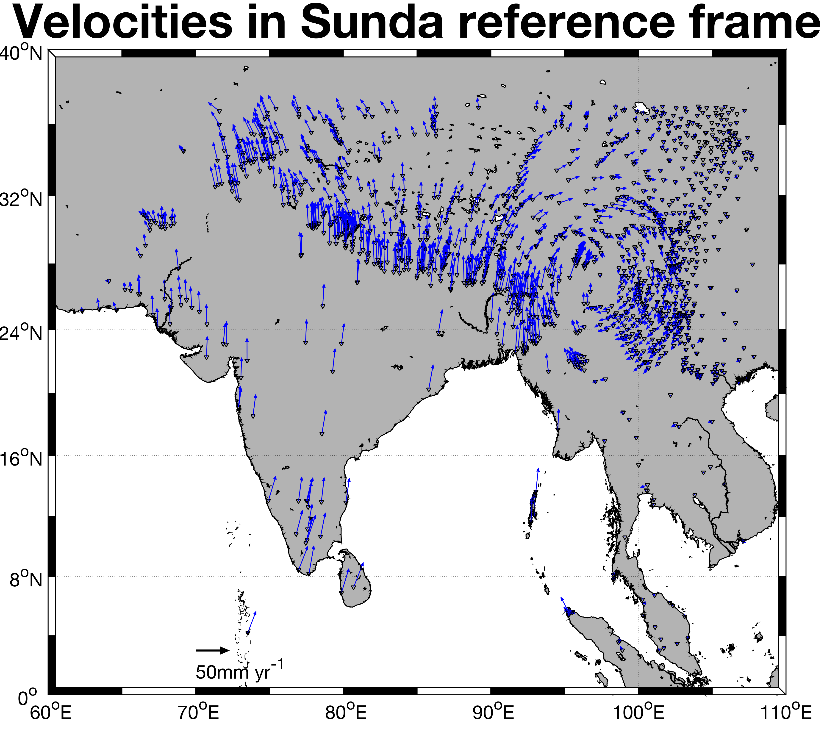
Reference frames and rotations (again)
Different from rotating vectors into different coordinate systems. Here the vector lengths itself change.

Slide 18
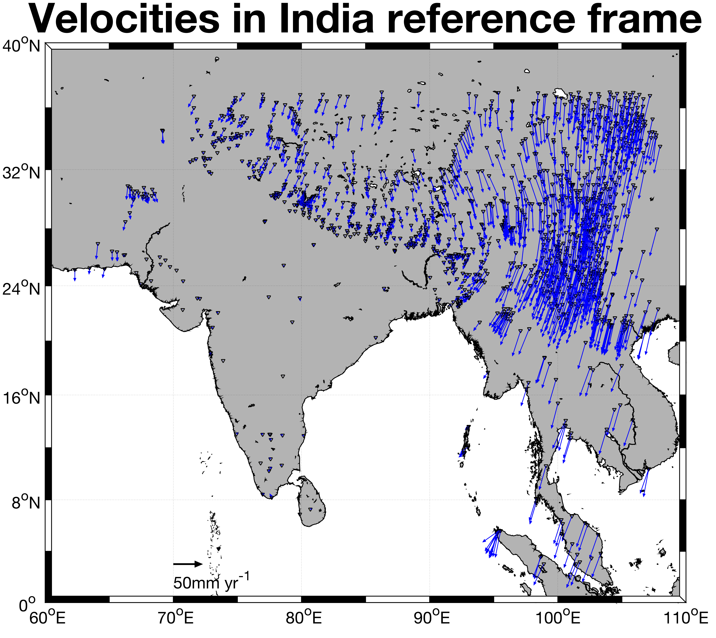
Reference frames and rotations (again)
Different from rotating vectors into different coordinate systems. Here the vector lengths itself change.

Slide 19
Assignment
First derive a linear operation that allows you to rotate the given velocity vectors to any coordinate system, for a known euler vector. Hint: rewrite the cross product as a multiplication of a matrix and a vector, and use the rotation operations we discussed earlier.
Now use this linear operation to predict the velocity field in the Indian subcontinent given an Euler pole (N – 51.42º, E – 2.10º, rotation rate – 0.5146 º/Myr). Compare the predicted velocities with the observed velocities.
Subtract this predicted velocity field at all sites and visualize the new transformed velocity field. What do you notice?
Repeat steps 2 and 3 by choosing the Eurasian Euler pole.
Reading Assignment:
McKenzie and Parker, (1967), The North Pacific - an Example of Tectonics on a Sphere, Nature
Avouac and Tapponnier, (1993), Kinematic Model of Active Deformation in Central Asia, GRL
Kogan et al., (2000), Geodetic Constraints on the Rigidity and Relative Motion of Eurasia and North America, GRL

Slide 20
